Slide 1
Lecture 21 Signals and Systems (ELL205)
By Dr. Abhishek Dixit
Dept. of Electrical Engineering
IIT Delhi

Slide 2
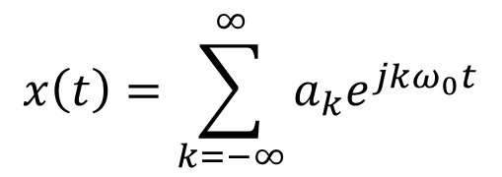

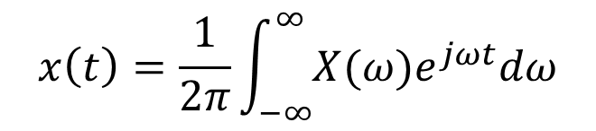

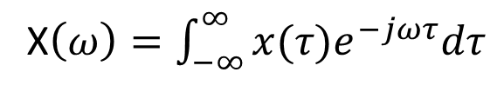
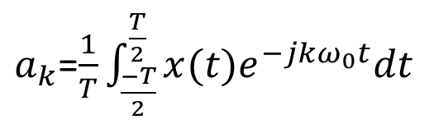
Analysis & Synthesis
$$x\left(t\right)=\sum_{k=−∞}^{∞}{a_{k}e^{jkω_{0}t}}$$
$$x\left(t\right)=\frac{1}{2π}\int_{−∞}^{∞}{X(ω)e^{jωt}dω}$$
Synthesis:
$ω→t$ Inverse Fourier Transform
$a_{k}$=$\frac{1}{T}\int_{\frac{−T}{2}}^{\frac{T}{2}}{x(t)e^{−jkω_{0}t}dt}$
X$\left(ω\right)=\int_{−∞}^{∞}{x(τ)e^{−jωτ}dτ}$
Analysis:
$t→ω$ Fourier Transform
Fourier Series
Fourier Transform

Slide 3
Problems
Fourier Transform of $u(t)$?

Slide 4
Problems
Fourier Transform of $u(t)$?
Method 1: $U\left(ω\right)=\int_{−∞}^{∞}{u(t)e^{−jωt}dt}=\int_{0}^{∞}{e^{−jωt}dt=\frac{−1}{jω}{\left(e^{−jωt}\right)}_{0}^{∞}}$ (Unsolvable)

Slide 5
Problems
Fourier Transform of $u(t)$?
Method 1: $U\left(ω\right)=\int_{−∞}^{∞}{u(t)e^{−jωt}dt}=\int_{0}^{∞}{e^{−jωt}dt=\frac{−1}{jω}{\left(e^{−jωt}\right)}_{0}^{∞}}$ (Unsolvable)
Method 2:
U(ω) = F{$\lim_{a→0}\left(e^{−at}u(t)\right)$}=$\lim_{a→0}\left(F\{e^{−at}u\left(t\right)\}\right)\text{=}\lim_{a→0}\left(\frac{1}{a+jω}\right)$

Slide 6
Problems
Fourier Transform of $u(t)$?
Method 1: $U\left(ω\right)=\int_{−∞}^{∞}{u(t)e^{−jωt}dt}=\int_{0}^{∞}{e^{−jωt}dt=\frac{−1}{jω}{\left(e^{−jωt}\right)}_{0}^{∞}}$ (Unsolvable)
Method 2:
U(ω) = F{$\lim_{a→0}\left(e^{−at}u(t)\right)$}=$\lim_{a→0}\left(F\{e^{−at}u\left(t\right)\}\right)\text{=}\lim_{a→0}\left(\frac{1}{a+jω}\right)$
Multiplying both numerator and denominator by $a−jω$
$\lim_{a→0}\left(\frac{1}{a+jω}\right)=\lim_{a→0}\left(\frac{a−jω}{a^{2}+ω^{2}}\right)=\lim_{a→0}\left(\frac{a}{a^{2}+ω^{2}}\right)$-$\lim_{a→0}\left(\frac{jω}{a^{2}+ω^{2}}\right)$

Slide 7
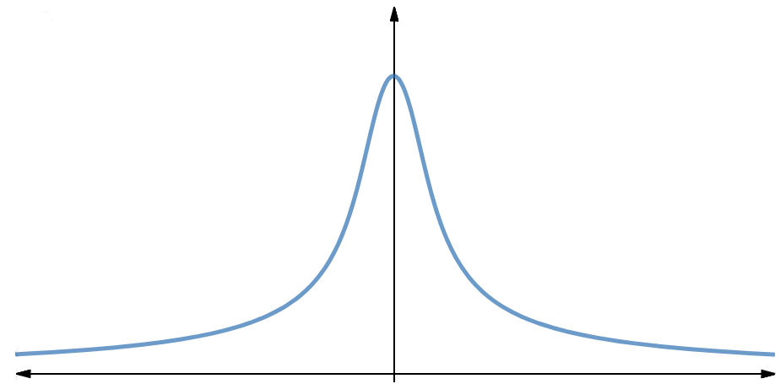
Problems
$$\frac{1}{a}$$
$$\frac{a}{a^{2}+ω^{2}} →$$
$$ω$$
$$−∞$$
$$ω=0$$
$$∞$$
Area under the curve = $\int_{−∞}^{∞}{\frac{a}{a^{2}+ω^{2}}dω=π }$(not a function of $a$)

Slide 8
Problems
$$\frac{1}{a}$$
$$\frac{a}{a^{2}+ω^{2}} →$$
$$ω$$
$$−∞$$
$$ω=0$$
$$∞$$
Area under the curve = $\int_{−∞}^{∞}{\frac{a}{a^{2}+ω^{2}}dω=π }$(not a function of $a$)
As $a→0$, the curve of $\frac{a}{a^{2}+ω^{2}}$ becomes narrower and narrower so that it results into a impulse at $ω=0$.
Therefore $\lim_{a→0}\left(\frac{a}{a^{2}+ω^{2}}\right)=πδ(ω)$

Slide 9
Problems
$$\lim_{a→0}\left(\frac{a}{a^{2}+ω^{2}}\right)=πδ(ω)$$
$$\lim_{a→0}\left(\frac{jω}{a^{2}+ω^{2}}\right)=\left\{\begin{aligned}0 when ω=0 \\ \frac{j}{ω} when ω≠0\end{aligned}\right.$$
$u\left(t\right)\underset{↔}{F.T.}\frac{1}{jω}+$ $πδ(ω)$
$\lim_{a→0}\left(\frac{1}{a+jω}\right)=\lim_{a→0}\left(\frac{a}{a^{2}+ω^{2}}\right)$-$\lim_{a→0}\left(\frac{jω}{a^{2}+ω^{2}}\right)=\left\{\begin{aligned}πδ\left(ω\right) when ω=0 \\ \frac{1}{jω} when ω≠0\end{aligned}\right.$

Slide 10
Problems
FT of $x\left(t\right)=rect\left(\frac{t}{T}\right)$ ?
$$T$$
$$𝔽$$
$$−\frac{T}{2}$$
$$0$$
$$+\frac{T}{2}$$
$$t$$

Slide 11
Problems
FT of $x\left(t\right)=rect\left(\frac{t}{T}\right)$ ?
$$X\left(ω\right)=\int_{−T/2}^{T/2}{e^{−jωt}dt}$$
$$X\left(ω\right)=\frac{−1}{jω}\left[e^{−jωT/2}−e^{jωT/2}\right]$$
$$T$$
$$𝔽$$
$$X\left(ω\right)=\frac{2}{ω2j}\left[{e^{jωT/2}−e}^{−jωT/2}\right]$$
$$−\frac{T}{2}$$
$$0$$
$$+\frac{T}{2}$$
$$t$$
$$X\left(ω\right)=\frac{2sin⁡(ωT/2)}{ω}$$
$$X\left(ω\right)=\frac{Tsin⁡(ωT/2)}{ωT/2}$$
$$X\left(ω\right)=Tsinc(ωT/2)$$

Slide 12
Problems
FT of $x\left(t\right)=rect\left(\frac{t}{T}\right)$ ?
$$T$$
$$𝔽$$
$$−\frac{T}{2}$$
$$0$$
$$+\frac{T}{2}$$
$$t$$
Proof: $X\left(ω\right)=\int_{−\frac{T}{2}}^{\frac{T}{2}}{e^{−jωt}dt}$ $=Tsinc\left(\frac{ωT}{2}\right)$

Slide 13
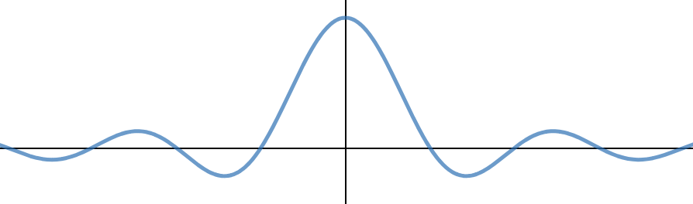
Problems
FT of $x\left(t\right)=rect\left(\frac{t}{T}\right)$ ?
X($ω$)
$$T$$
$$T$$
$$𝔽$$
$$t$$
$$ω$$
$$−\frac{T}{2}$$
$$0$$
$$+\frac{T}{2}$$
$$t$$
$$−\frac{2π}{T}$$
$$0$$
$$\frac{2π}{T}$$
Proof: $X\left(ω\right)=\int_{−\frac{T}{2}}^{\frac{T}{2}}{e^{−jωt}dt}$ $=Tsinc\left(\frac{ωT}{2}\right)$

Slide 14
Problems
What is the area of $Tsinc\left(\frac{ωT}{2}\right)$?

Slide 15
Problems
What is the area of $Tsinc\left(\frac{ωT}{2}\right)$?
$$Tsinc\left(\frac{ωT}{2}\right)$$
$$ω$$
$$−\frac{2π}{T}$$
$$0$$
$$\frac{2π}{T}$$
Area=$\frac{1}{2}×\frac{4π}{T}×T=2π$

Slide 16
Moments theorem
Area of spectrum = 2π$×x(0)$
$$x\left(t\right)=\frac{1}{2π}\int_{−∞}^{∞}{X(ω)e^{jωt}dω}$$
$$2πx\left(0\right)=\int_{−∞}^{∞}{X(ω) dω}$$
Synthesis:
t$=0$
Area of time domain signal = X$(0)$
X$\left(ω\right)=\int_{−∞}^{∞}{x(τ)e^{−jωτ}dτ}$
$$X(0)=\int_{−∞}^{∞}{x(t) dt}$$
Analysis:
ω$=0$

Slide 17
Problems
FT of $x\left(t\right)=rect\left(\frac{t}{T}\right)$ ?
X($ω$)
$$T$$
$$T$$
$$𝔽$$
$$t$$
$$ω$$
$$−\frac{T}{2}$$
$$0$$
$$+\frac{T}{2}$$
$$t$$
$$−\frac{2π}{T}$$
$$0$$
$$\frac{2π}{T}$$
Proof: $X\left(ω\right)=\int_{−\frac{T}{2}}^{\frac{T}{2}}{e^{−jωt}dt}$ $=Tsinc\left(\frac{ωT}{2}\right)$

Slide 18
Try it yourself
$$x(t)$$
$$4$$
$$𝔽$$
$$A$$
$$t$$
$$−W$$
$$W$$
$$ω$$
$$−π$$
$$0$$
$$π$$
What are W and A?
1) | 2)
3) | 4)
$$A=4π \& W=1$$
$$A=4π \& W=2$$
$$A=2π \& W=2$$
$$A=2π \& W=1$$

Slide 19
Rect & Sinc Pair
$$T$$
$$t$$

Slide 20
Rect & Sinc Pair
$$T$$
$$t$$

Slide 21
Rect & Sinc Pair
$$T$$
$$t$$

Slide 22
Rect & Sinc Pair
Area is preserved to 2π
$$T$$
$$t$$

Slide 23
Rect & Sinc Pair
Area is preserved to 2π
X(ω)$→$2πδ(ω)
$$T→∞$$
$$t$$

Slide 24
Fourier Transforms
Fourier Transform of $1$ is $X\left(ω\right)$
How many statements are correct?
1) $X\left(ω\right)=2πδ(ω)$ | 2) $X\left(ω\right)=2δ(ω)$
3) $X\left(ω\right)=πδ(ω)$ | 4) $X\left(ω\right)=δ(ω)$

Slide 25
Fourier Transforms
Fourier Transform of $1$ is $2πδ(ω)$

Slide 26
Fourier Transforms
Fourier Transform of $1$ is $2πδ(ω)$
$$2πδ(ω)=\int_{−∞}^{∞}{e^{−jωt}dt}$$

Slide 27
Fourier Transforms
Fourier Transform of $1$ is $2πδ(ω)$
$$2πδ(ω)=\int_{−∞}^{∞}{e^{−jωt}dt}$$
$$2πδ(ω−ω_{0})=\int_{−∞}^{∞}{e^{−j\left(ω−ω_{0}\right)t}dt}$$

Slide 28
Fourier Transforms
Fourier Transform of $1$ is $2πδ(ω)$
$$2πδ(ω)=\int_{−∞}^{∞}{e^{−jωt}dt}$$
$$2πδ(ω−ω_{0})=\int_{−∞}^{∞}{e^{−j\left(ω−ω_{0}\right)t}dt}$$
$$2πδ(ω−ω_{0})=\int_{−∞}^{∞}{e^{jω_{0}t}e^{−jωt}dt}$$

Slide 29
Fourier Transforms
Fourier Transform of $1$ is $2πδ(ω)$
$$2πδ(ω)=\int_{−∞}^{∞}{e^{−jωt}dt}$$
$$2πδ(ω−ω_{0})=\int_{−∞}^{∞}{e^{−j\left(ω−ω_{0}\right)t}dt}$$
$$2πδ(ω−ω_{0})=\int_{−∞}^{∞}{e^{jω_{0}t}e^{−jωt}dt}$$
$$2πδ(ω−ω_{0})=F[e^{jω_{0}t}]$$

Slide 30

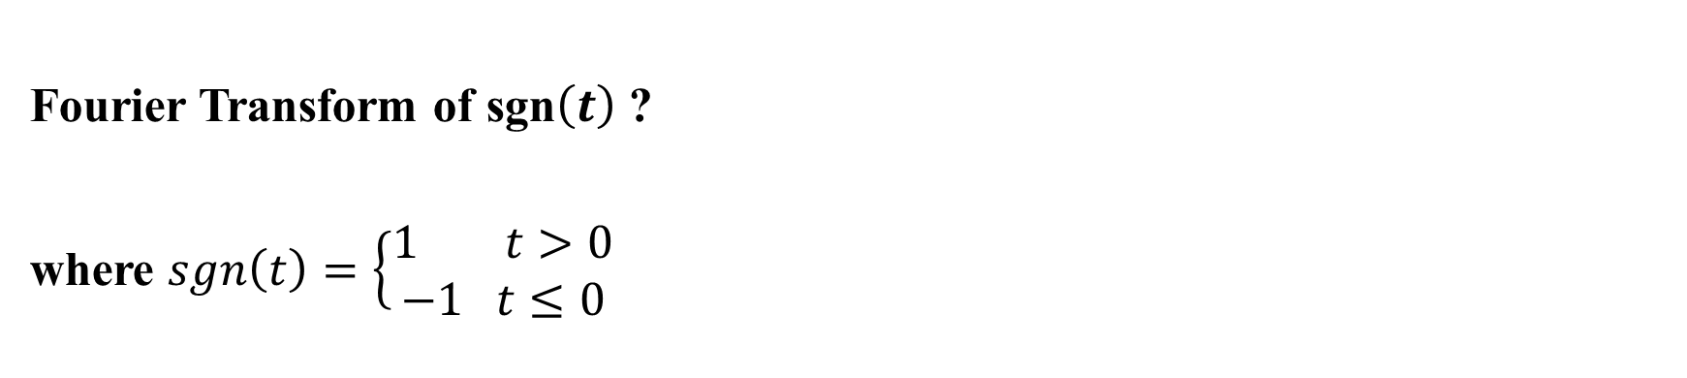






Problems
Fourier Transform of sgn$\left(t\right)$ ?
where $sgn\left(t\right)=\left\{\begin{aligned}1 t>0 \\ −1 t≤0\end{aligned} \right.$
$$Sgn\left(t\right)=u\left(t\right)−u(−t)$$
$$+1$$
$$t$$
$$−∞$$
$$0$$
$$∞$$
$$−1$$

Slide 31
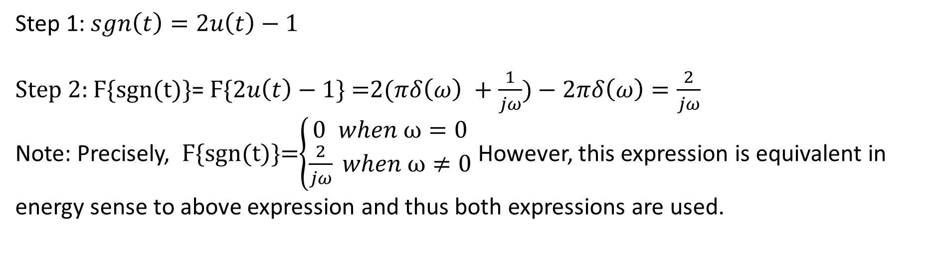
Problems
Fourier Transform of sgn$\left(t\right)$ ?
where $sgn\left(t\right)=\left\{\begin{aligned}1 t>0 \\ −1 t≤0\end{aligned} \right.$
$$Sgn\left(t\right)=u\left(t\right)−u(−t)$$
$$+1$$
$$t$$
$$−∞$$
$$0$$
$$∞$$
$$−1$$
Step 1: $sgn\left(t\right)=2u\left(t\right)−1$
Step 2: Ϝ{sgn(t)}= Ϝ{$2u\left(t\right)−1$} =2($πδ\left(ω\right) +\frac{1}{jω})−2πδ\left(ω\right)=\frac{2}{jω}$
Note: Precisely, Ϝ{sgn(t)}=$\left\{\begin{aligned}0 when ω=0 \\ \frac{2}{jω} when ω≠0\end{aligned}\right.$ However, this expression is equivalent in energy sense to above expression and thus both expressions are used.

Slide 32
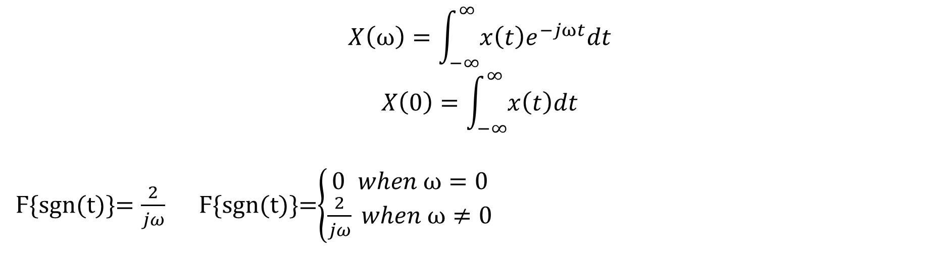
Problems
Fourier Transform of sgn$\left(t\right)$ ?
where $sgn\left(t\right)=\left\{\begin{aligned}1 t>0 \\ −1 t≤0\end{aligned} \right.$
$$Sgn\left(t\right)=u\left(t\right)−u(−t)$$
$$+1$$
$$t$$
$$−∞$$
$$0$$
$$∞$$
$$−1$$
$$X\left(ω\right)=\int_{−∞}^{∞}{x\left(t\right)e^{−jωt}dt}$$
$$X\left(0\right)=\int_{−∞}^{∞}{x\left(t\right)dt}$$
Ϝ{sgn(t)}$=\frac{2}{jω}$ Ϝ{sgn(t)}=$\left\{\begin{aligned}0 when ω=0 \\ \frac{2}{jω} when ω≠0\end{aligned}\right.$

Slide 33
Fourier Transforms
Fourier Transform of $δ\left(t\right)$ is $X\left(ω\right)$
How many statements are correct?
1) $X\left(ω\right)=1$ | 2) $\left|X(ω\text{) }\right|$is an even function
3) $∠X(ω$) is an odd function | 4) $X(ω\text{) }$is a low pass filter

Slide 34
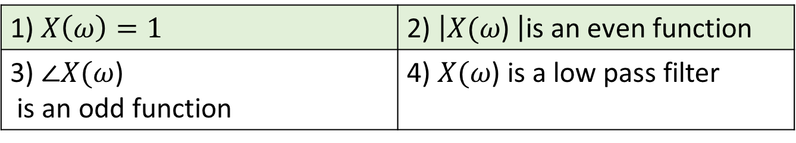
Fourier Transforms
Fourier Transform of $δ\left(t\right)$ is $X\left(ω\right)$
How many statements are correct?
1) $X\left(ω\right)=1$ | 2) $\left|X(ω\text{) }\right|$is an even function
3) $∠X(ω$) is an odd function | 4) $X(ω\text{) }$is a low pass filter

Slide 35
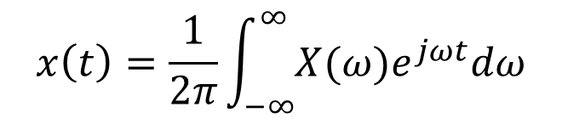


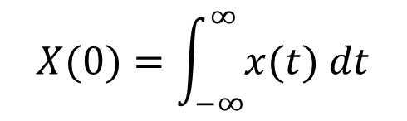
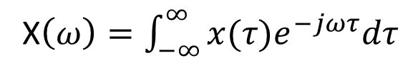
F. T. of Periodic Signal
$$x\left(t\right)=\sum_{k=−∞}^{∞}{a_{k}e^{jkω_{0}t}}$$
F. T. $X\left(ω\right)=\sum_{k=−∞}^{∞}{a_{k}2πδ(ω−kω_{0})}$ (F.T. of a periodic signal)
Spectrum is composed of impulses (Discrete spectrum).
In F. S. we plot $a_{k}$ by $k$.
In F. T. we plot $X(ω)$ by $ω$.
$$X(ω)$$
$$2πa_{1}$$
$$2πa_{2}$$
$$ω$$
$${−2ω}_{0}$$
$${−ω}_{0}$$
$$0$$
$$ω_{0}$$
$${2ω}_{0}$$

Slide 36
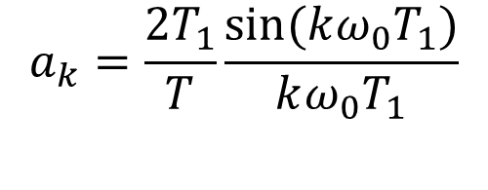

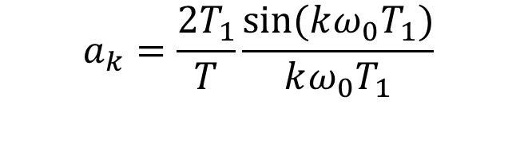

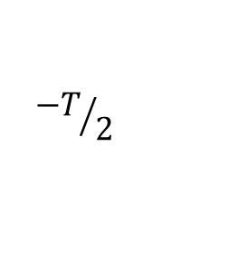


Problem
Draw the spectrum of $x\left(t\right)=cos\left(ω_{0}t\right).$
$$\cos\left(ω_{0}t\right)=\frac{1}{2}(e^{jω_{0}t}+e^{−jω_{0}t})$$
$$X(ω)=\frac{1}{2}×2πδ\left(ω−ω_{0}\right)+\frac{1}{2}×2πδ\left(ω+ω_{0}\right)$$
$$X(ω)=πδ\left(ω−ω_{0}\right)+πδ\left(ω+ω_{0}\right)$$
$$2π×\frac{1}{2}=π$$
$$X(ω)$$
$$2π×\frac{1}{2}=π$$
$$ω$$
$$−ω_{0}$$
$$ω_{0}$$

Slide 37


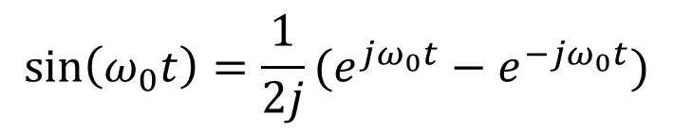

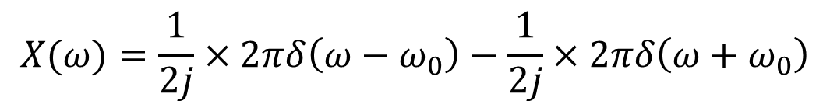

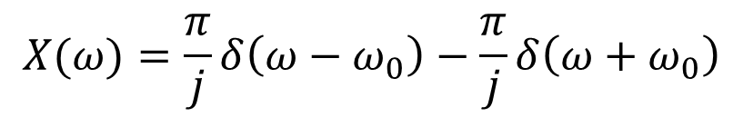


Problem
Draw the spectrum of $x\left(t\right)=sin\left(ω_{0}t\right).$
$$\sin\left(ω_{0}t\right)=\frac{1}{2j}(e^{jω_{0}t}−e^{−jω_{0}t})$$
$$X(ω)=\frac{1}{2j}×2πδ\left(ω−ω_{0}\right)−\frac{1}{2j}×2πδ\left(ω+ω_{0}\right)$$
$$X(ω)=\frac{π}{j}δ\left(ω−ω_{0}\right)−\frac{π}{j}δ\left(ω+ω_{0}\right)$$
$$X(ω)$$
$$\frac{π }{j}$$
$$−ω_{0}$$
$$ω_{0}$$
$$ω$$
-$\frac{π }{j}$

Slide 38
Fourier Transforms pairs
$$x(t)$$ | X$(ω)$
$e^{−at}u\left(t\right)$, $\text{where} a>0$ | $$\frac{1}{a+jω}$$
$e^{−a\left|t\right|}$, $\text{where} a>0$ | $$\frac{2a}{a^{2}+ω^{2}}$$
$$δ\left(t\right)$$ | $$1$$
1 | 2π$δ(ω)$
$$rect\left(\frac{t}{T}\right)$$ | $$Tsinc\left(\frac{ωT}{2}\right)$$
$$\frac{W}{2π}sinc\left(\frac{Wt}{2}\right)$$ | $$rect\left(\frac{ω}{W}\right)$$

Slide 39
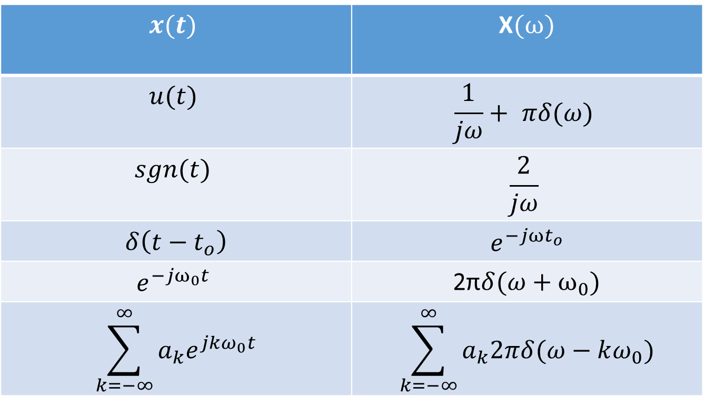
Fourier Transforms pairs
$$x(t)$$ | X$(ω)$
$$u(t)$$ | $$\frac{1}{jω}+ πδ(ω)$$
$$sgn(t)$$ | $$\frac{2}{jω}$$
$$δ\left(t−t_{o}\right)$$ | $$e^{−jωt_{o}}$$
$$e^{−jω_{0}t}$$ | 2π$δ(ω+ω_{0})$
$$\sum_{k=−∞}^{∞}{a_{k}e^{jkω_{0}t}}$$ | $$\sum_{k=−∞}^{∞}{a_{k}2πδ(ω−kω_{0})}$$

